Slide 1
Registration Only

Slide 2
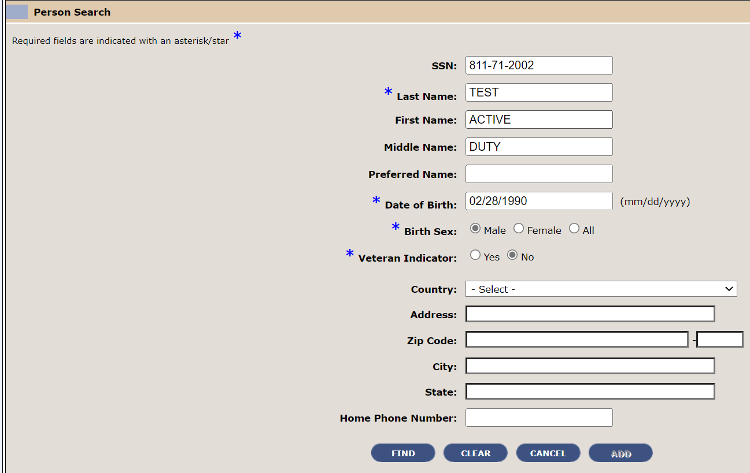
Registration only
For all new registrations, follow your normal procedures to Add-A-Person:
SSN
Last Name
First Name
Middle Name
Date of Birth
Birth Sex
Veteran Indicator: Yes or No

Slide 3
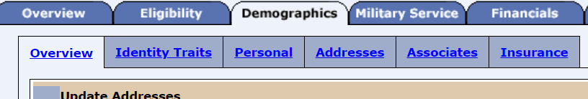
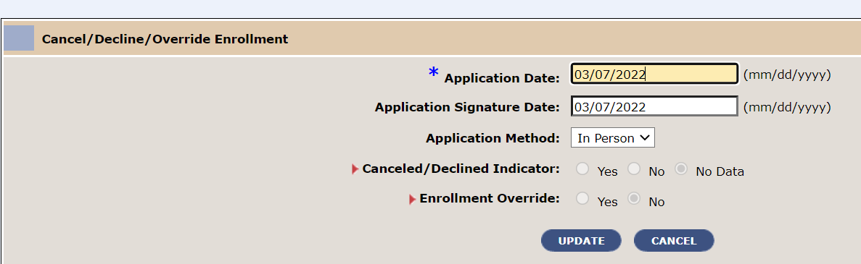
Registration only
Follow your normal procedures to update the following tabs:
Demographics
Enrollment

Slide 4
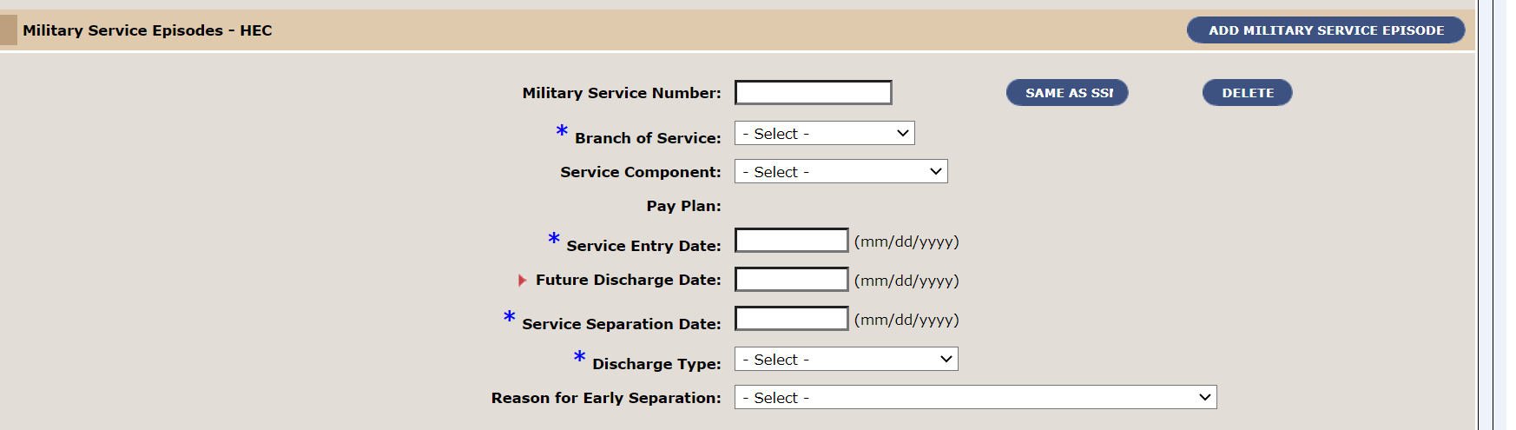
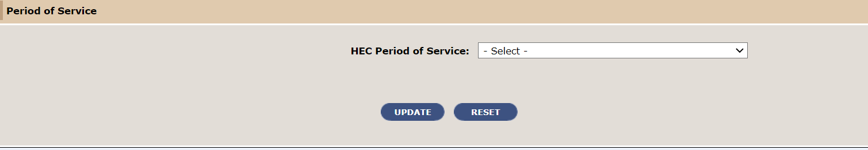
Registration only
For records where the Veteran Indicator is Yes. Complete the Military Service tab.

Slide 5
Active-Duty Service Members Registration

Slide 6
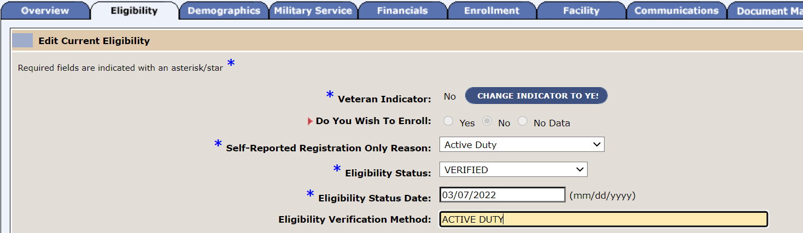
Active duty registration
On the Eligibility Tab the Veteran Indicator will populate from the AAP Search Screen.
Do You Wish To Enroll: is auto set to No because the Veteran Indicator is No.
If you in error mark Veteran Indicator Yes on the AAP search then add. Change the
Veteran Indicator to No and Do You Wish To Enroll to No.
Self-Reported Registration Reason: Active Duty
Eligibility Status: Verified
Eligibility Status Date: Today’s Date
Eligibility Verification Method: Active Duty

Slide 7
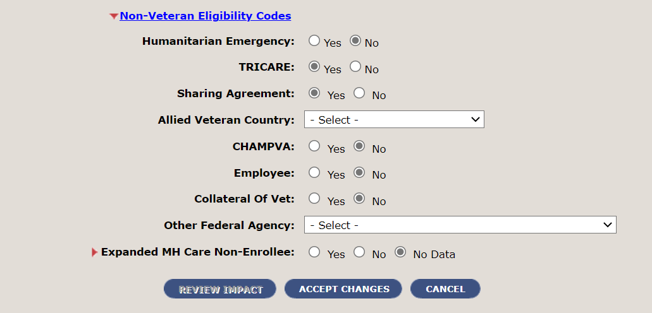
Active duty registration
At the bottom of the Eligibility Tab scroll to Non-Veteran Eligibility Codes. Update the
record as follows: (Important: Both MUST be selected to ensure proper billing.)
Tricare: Yes
Sharing Agreement: Yes
Select Accept Changes.

Slide 8
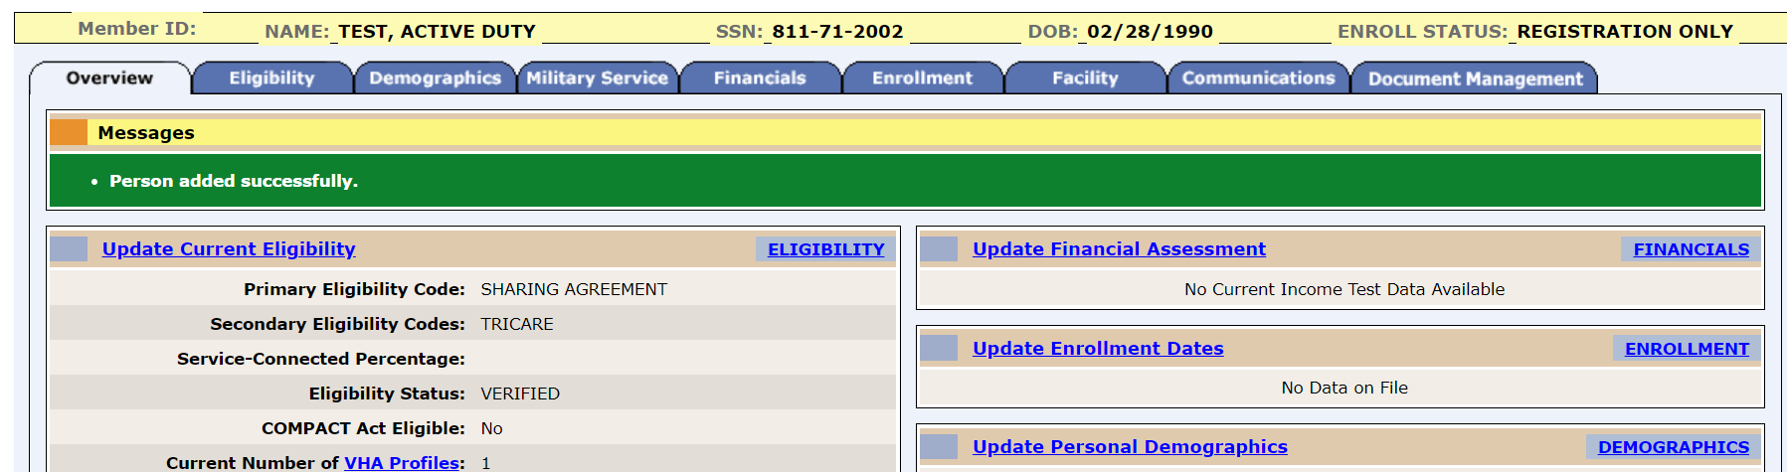
Active duty registration
Once you complete the Eligibility, Demographics, and Enrollment tabs.
You will Save in Process and Complete Registration. The record will show an
Enrollment Status of Registration Only.

Slide 9
Future Date of Discharge

Slide 10
Active duty with future date of discharge
Important: Do not add Future Date of Discharge if you do not have a signed
10-10EZ from the Veteran.
VA Form 10-0454 is not authorized and shall not be used to enroll a service
member transitioning from active duty. It may be used for REGISTRATION ONLY.
The service members MUST complete VA Form 10-10EZ to be enrolled in VA
health care.
Follow your normal procedures to register an Active Duty service member.
AAP
Eligibility
Enrollment
Demographics

Slide 11
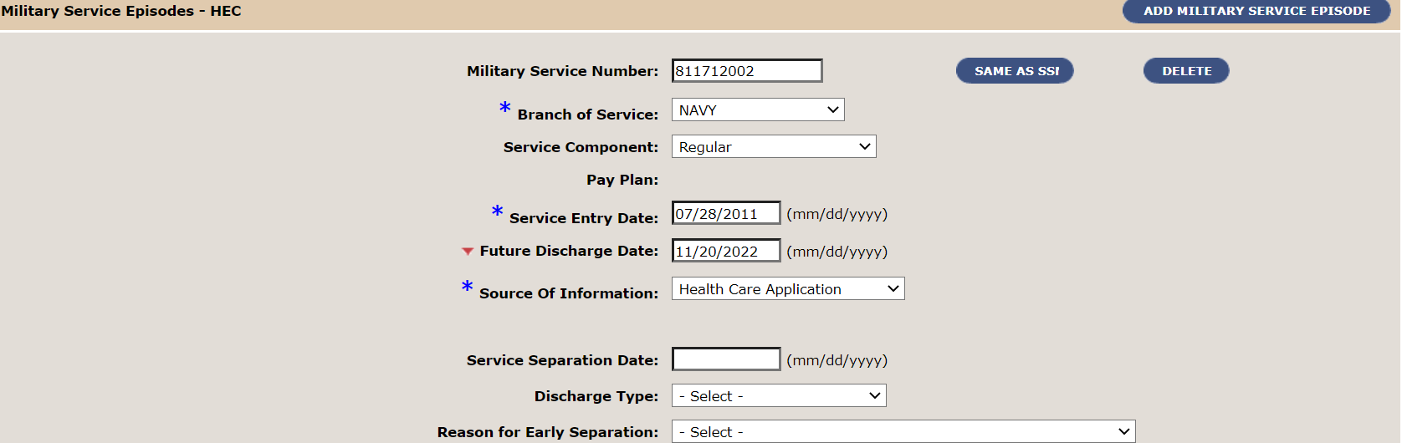
Active duty registration WITH FUTURE DATE OF DISCHARGE
Update the Military Service Tab as follows: (Important: Do not add Combat Episodes).
Military Service Number: Select Same as SSN
Branch of Service: select from drop-down
Service Entry Date:
Future Date of Discharge: Must be within 365 days.
Press the Tab button on the keyboard to populate the Source of Information and select
From the drop-down.

Slide 12
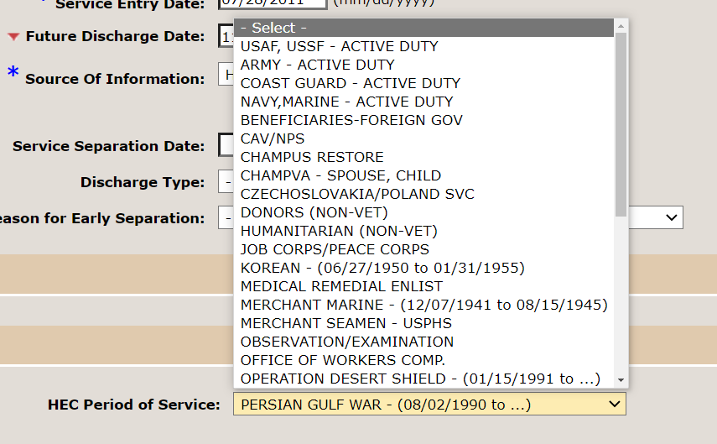
Active duty registration
Period of Service: Select their branch of service with Active Duty from the drop-down.
Select Update.

Slide 13
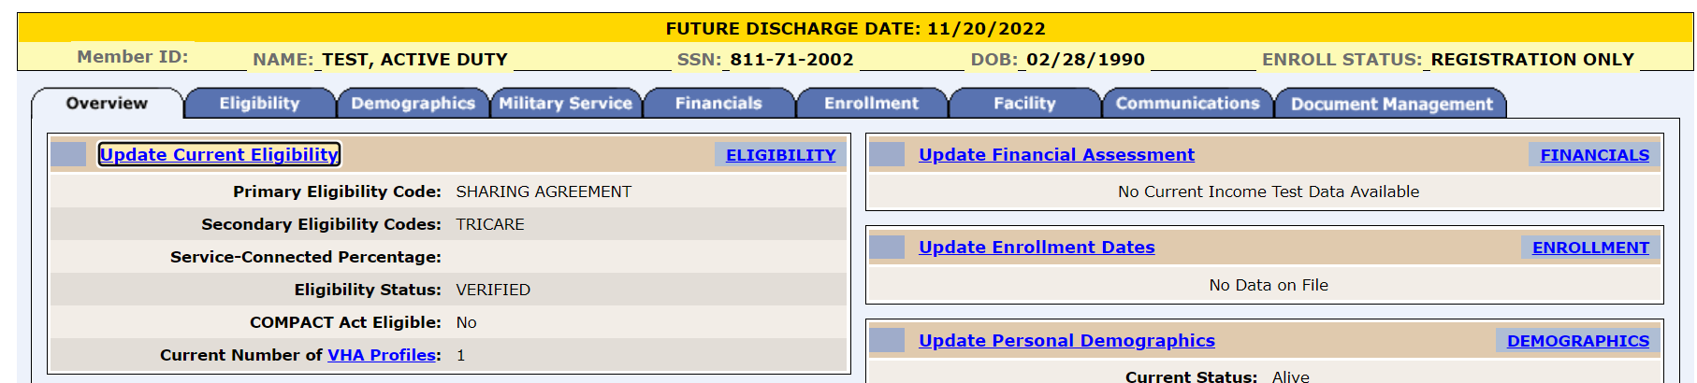
Active duty registration with future date of discharge
Once you complete the Eligibility, Demographics, Enrollment tabs. You will Save in Process and Complete Registration. Then add Military, the record will show an Enrollment Status of Registration Only with a Future Date Discharge banner that includes the FDD date.

Slide 14
Presumptive Psychosis and Military Sexual Trauma Registration

Slide 15
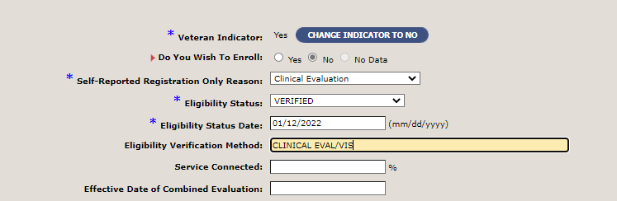
Pp and mst REGISTRATION
To Register complete the following on the Eligibility tab.
Veteran Indicator: Yes
Do You Wish To Enroll: No
Self-Reported Registration Only Reason: Clinical Evaluation
Eligibility Status: Verified
Eligibility Status Date: Today’s Date
Eligibility Verification Method: Clinical Eval/System or Document Used
Select Accept Changes
Relation Type – Associate Change History Page

Slide 16
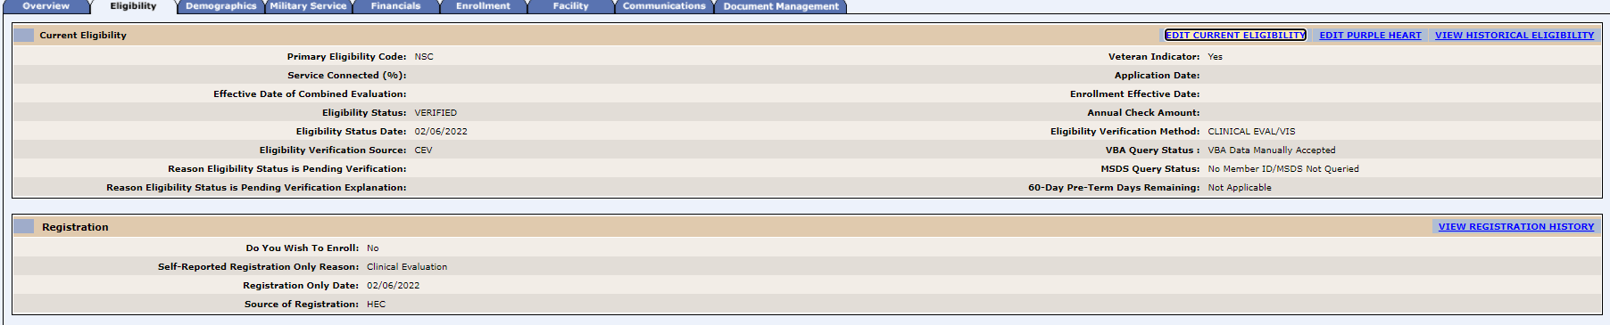
Pp and mst REGISTRATION
From the ESR Registration banner select Save in Process, then Complete Registration.
The Enrollment Status to ‘Registration Only’ and Primary Eligibility Code will be Non-Service Connected.
Relation Type – Associate Change History Page

Slide 17
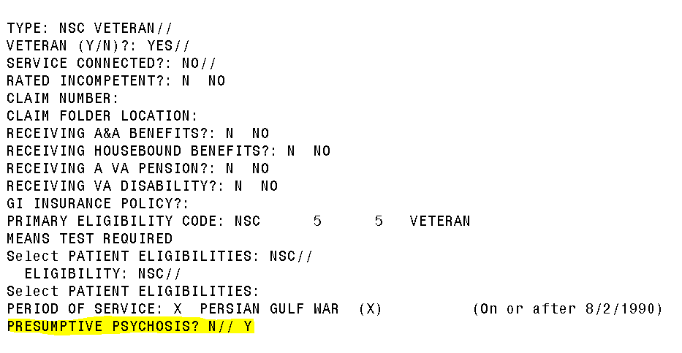
Presumptive psychosis - vista registration
A new field was created in VistA registration screen 7 to enable users to enter the reason a Veteran qualifies for Presumptive Psychosis.

Slide 18
Presumptive psychosis - vista registration
Select the appropriate option from the category list:
REJ REJECTED DUE TO INCOME
LES LESS THAN 24 MONTHS SERVICE
OTH FSM WITH OTH (PP ONLY)
DEC VETERAN DECLINES ENROLLMENT
Even if you register a Veteran in ES, go into VistA screen 7 to select the reason as there are now VistA Presumptive Psychosis reports based on this data.

Slide 19
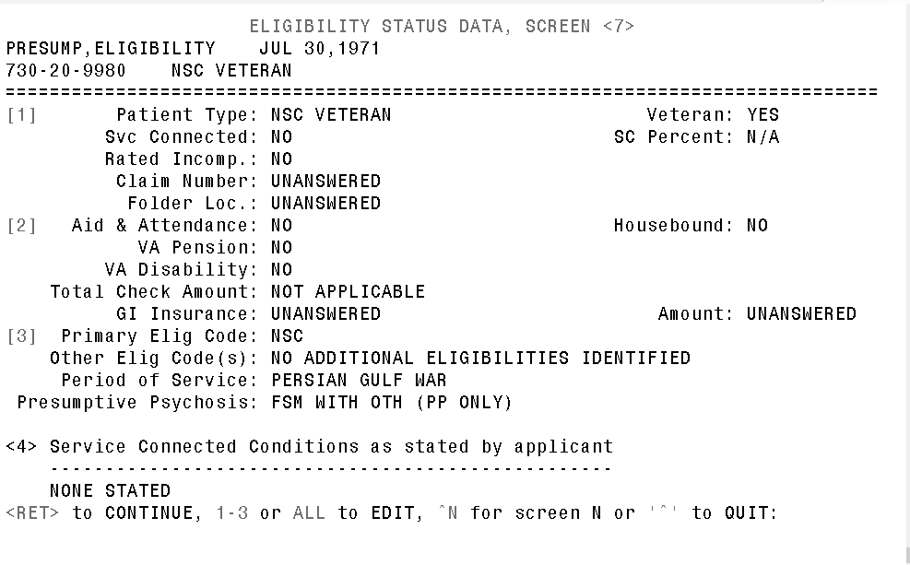
Presumptive psychosis - vista registration
Screen 7 will display as follows:

Slide 20
PRESUMPTIVE ELIGIBILITY FOR PSYCHOSIS AND
OTHER MENTAL ILLNESS AUTHORITY
After a determination is made by a VHA Clinician, if they are positively screened update the Veteran record with service connection code 9410 at 0% with the date the clinician made the decision.
Update the record in VistA or ES.
Important: ES is the authoritative source of information.

Slide 21
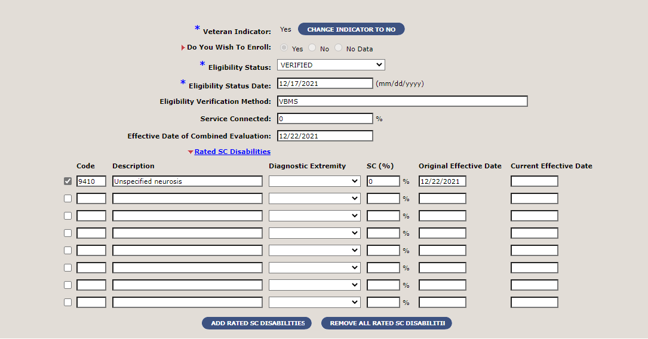
PRESUMPTIVE ELIGIBILITY FOR PSYCHOSIS AND
OTHER MENTAL ILLNESS AUTHORITY
ES UPDATE

Slide 22
OTH Mental Health Registration

Slide 23
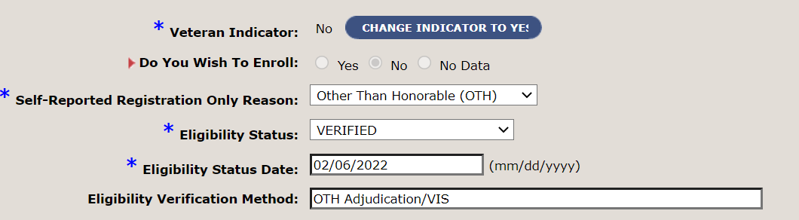
Oth mental health REGISTRATION
To Register complete the following on the Eligibility tab.
Veteran Indicator: No
Do You Wish To Enroll: No
Self-Reported Registration Only Reason: Other than Honorable
Eligibility Status: Verified
Eligibility Status Date: Today’s Date
Eligibility Verification Method: OTH Adjudication/System or Document Used
Note: This will be the same for both Emergent and Extended MH Factors.
Relation Type – Associate Change History Page

Slide 24
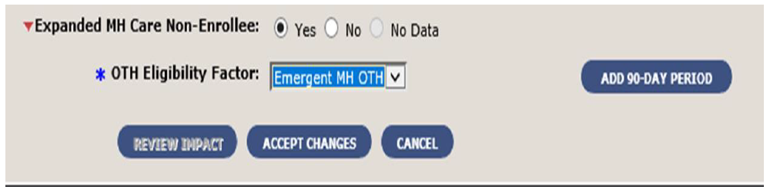
OTH Eligibility Factor – Emergent MH OTH
Emergent MH OTH – immediate need for emergency mental health care (for OTH Veterans who did not serve in a combat zone or experience military sexual trauma) for a 90-day episode of care
When this value is selected, the Add 90-Day Period button appears.
Additional 90-day periods may be authorized by VISN Chief Medical Officer

Slide 25
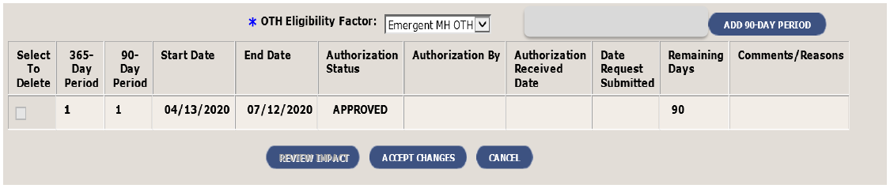
OTH Eligibility Factor – emergent MH Oth
After the user selects the button, a grid with the additional fields is displayed. For the initial 90-day period of care, the system sets all the applicable fields:
The 365-Day Period and the 90-Day Period= “1”, and the Start Date=current date
The End Date = ‘Start Date + 90 days’
The Authorization Status = “Approved”
The Remaining Days field = 90. (The system calculates and displays the Remaining Days. This field counts down so the user always sees how many days are left in the current 90-day period of care. For the initial 90-Day period, the 1st day is counted as zero).
Upon clicking Accept Changes, the system sets the Enrollment Status to ‘Registration Only; and the Period of Service (POS) to ‘OTHER NON-VETERANS’.

Slide 26
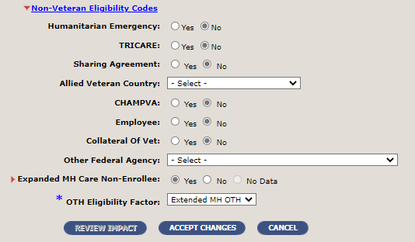
Oth mental health REGISTRATION (combat/mst)
Scroll to the bottom to update the Non-Veteran Eligibility Code as follows:
Expanded MH Care Non-Enrollee : Yes
OTH Eligibility Factor: Extended MH OTH
Select Accept Changes
Relation Type – Associate Change History Page

Slide 27
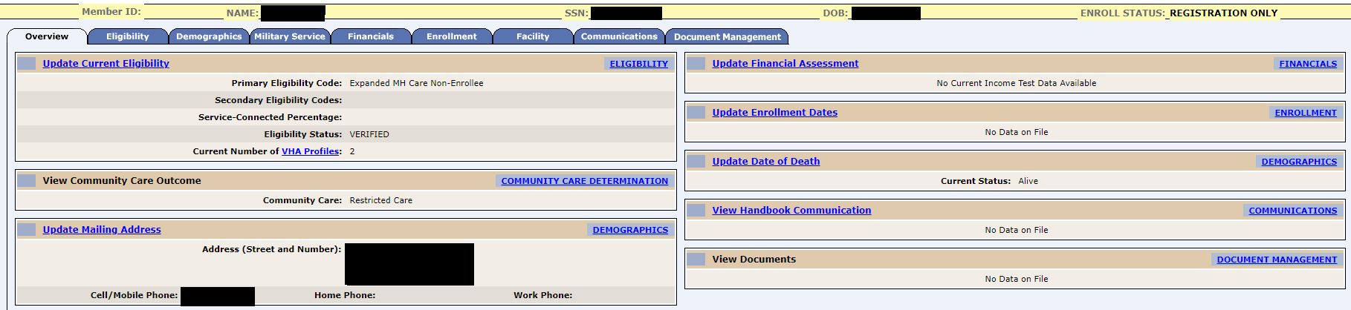
Oth mental health REGISTRATION (combat/mst)
From the ESR Registration banner select Save in Process, then Complete Registration.
The Enrollment Status to ‘Registration Only’ and Primary Eligibility Code will be Expanded MH Care Non-Enrollee.
Relation Type – Associate Change History Page

Slide 28
Collateral Registration

Slide 29
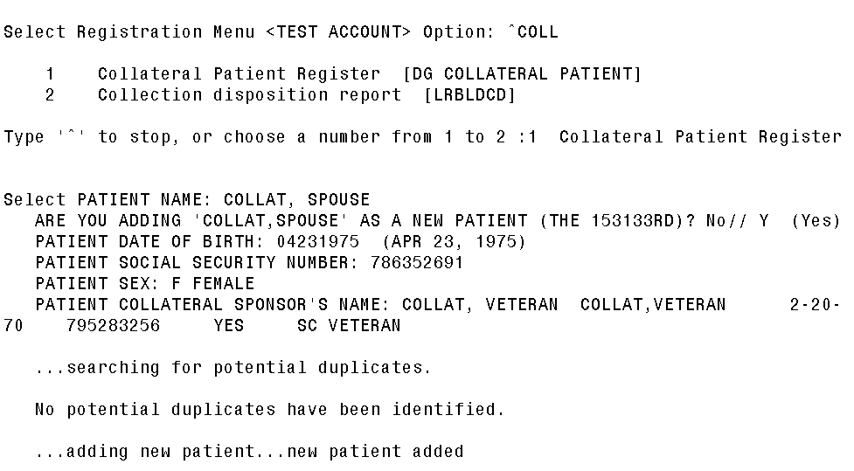
Registering a new collateral in vista
Register a Collateral using ^COLL
Enter the following for the Collateral
Full Name
Date of Birth
SSN
Sex
Collateral Sponsor Name

Slide 30
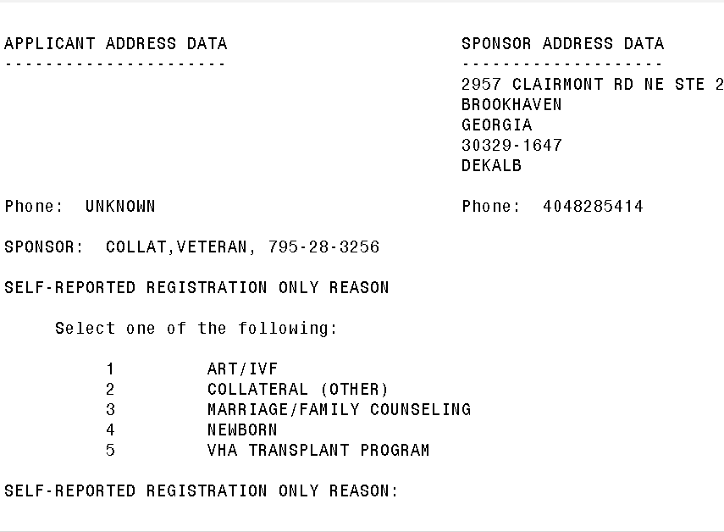
Registering a new collateral
Select the appropriate Self-Reported Registration Only Reason
1 ART/IVF
2 Collateral (Other) (Used for Spouses, Caregivers, Dependents or other associated
with the Veteran
3 Marriage/Family Counseling
4 Newborn
5 VHA Transplant Program

Slide 31
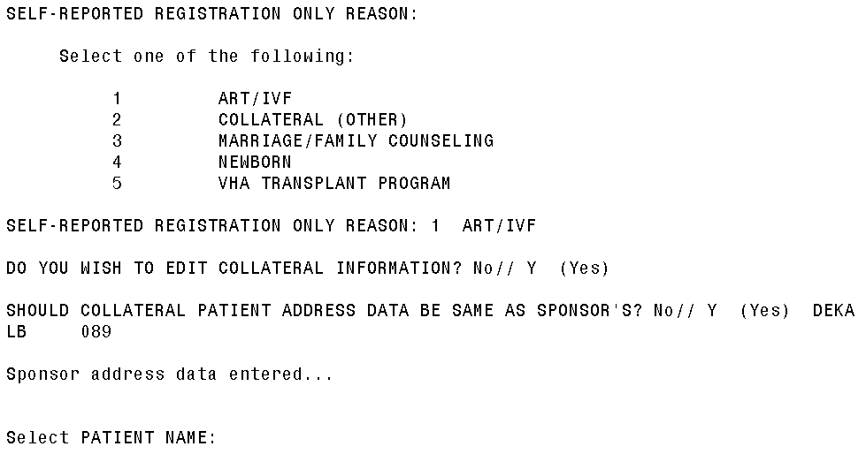
Registering a new collateral
Do You Wish To Edit Collateral Information? No// Y
Should Collateral Patient Address Data Be Same As Sponsor’s? Y if the same N if
Different.
After entering the address. Proceed to the ^REG Menu

Slide 32
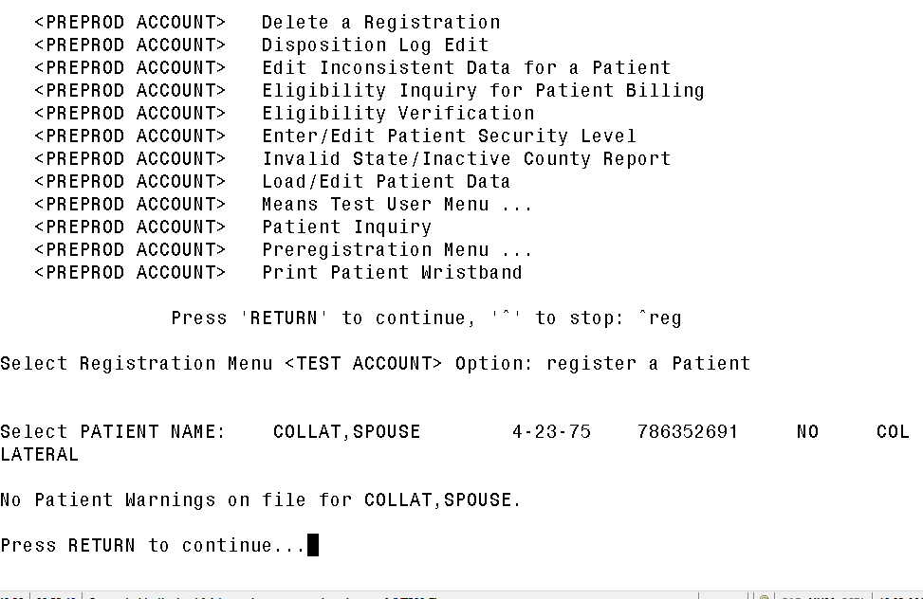
Registering a new collateral
Once at the REG Menu. Press Space Bar and Enter to bring up the last Collateral entered
Follow your normal procedures to update registration record details

Slide 33
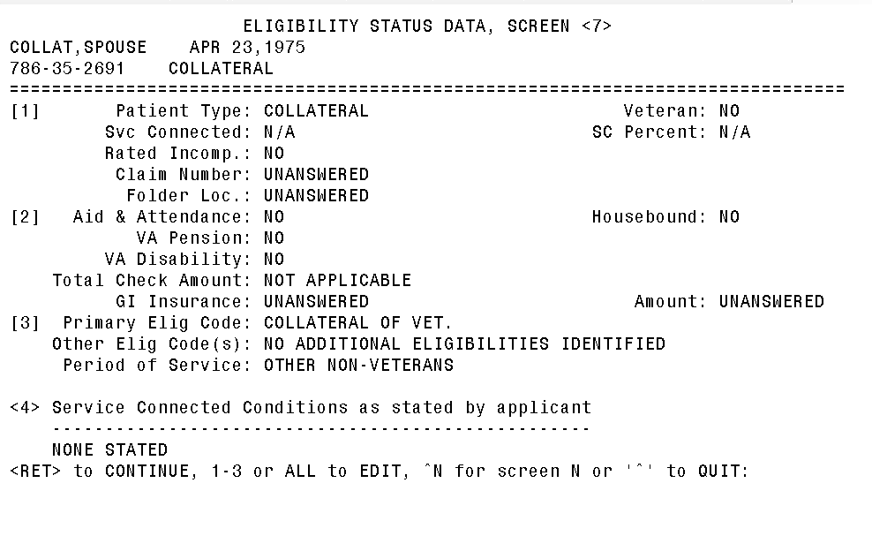
Registering a new collateral
Primary Eligibility to Collateral of Vet, Screen <7>,
Period of Service Other Non-Veterans

Slide 34
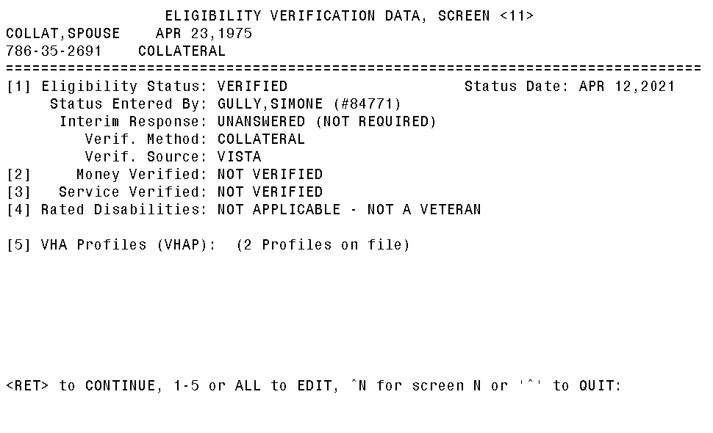
Registering a new collateral
Setting the Eligibility Verification Data, Screen <11>,
Eligibility Status: Verified
Eligibility Status Date: Today’s Date
Eligibility Verification Method: COLLATERAL

Slide 35
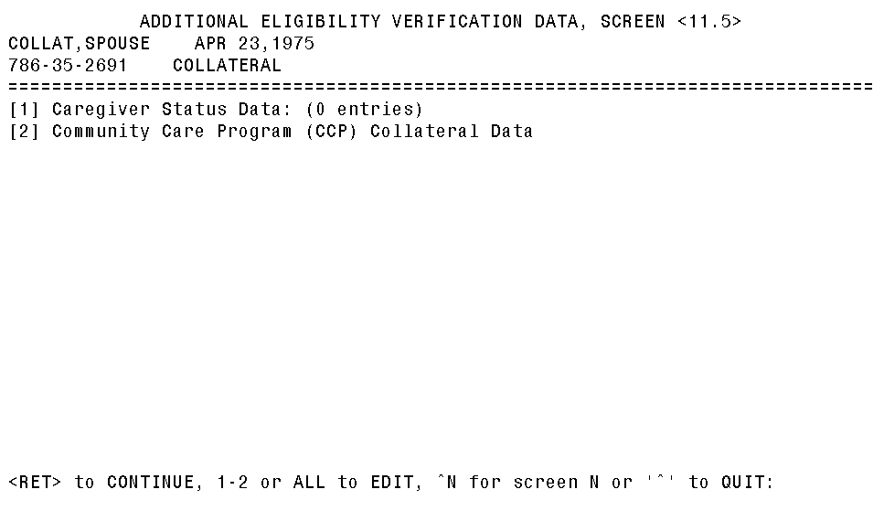
Registering a new collateral
Setting the Additional Eligibility Verification Data, Screen <11.5>,
Enter 2 for Community Care Program (CCP) Collateral Data

Slide 36
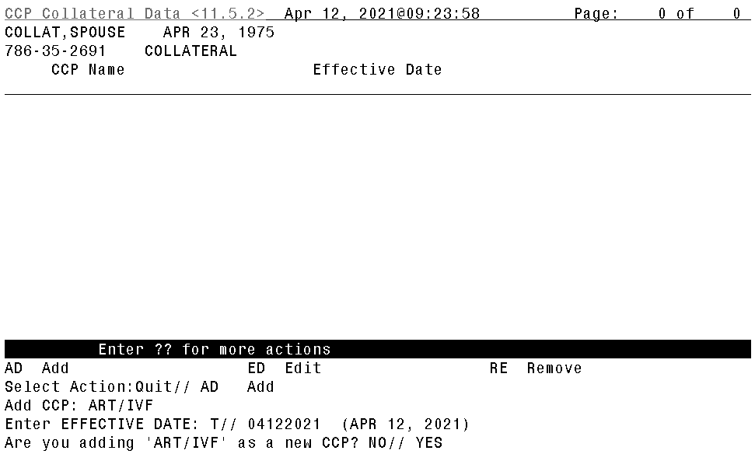
Registering a new collateral
Select AD to Add the CCP
Enter one of the following: (A – ART/IVF, C – MARRIAGE/FAMILY COUSELING,
I – NEWBORN, or T – VHA TRANSPLANT PROGRAM)
Enter the Effective Date of eligibility
Answer Y to the Are you adding ?
Complete the registration and follow your normal procedures to Disposition the record.

Slide 37
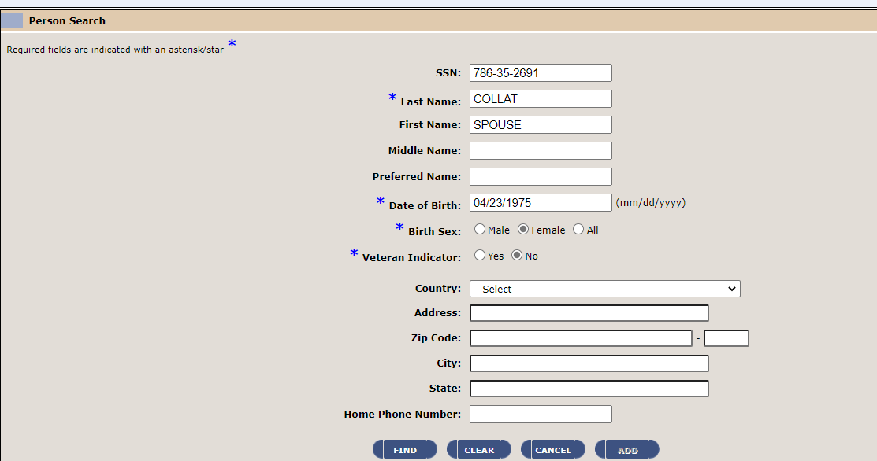
Registering a NEW Collateral in ES Follow the normal procedure to Add A Person (AAP) with the additional step of setting the Veteran Indicator to No.
Registering a new collateral

Slide 38
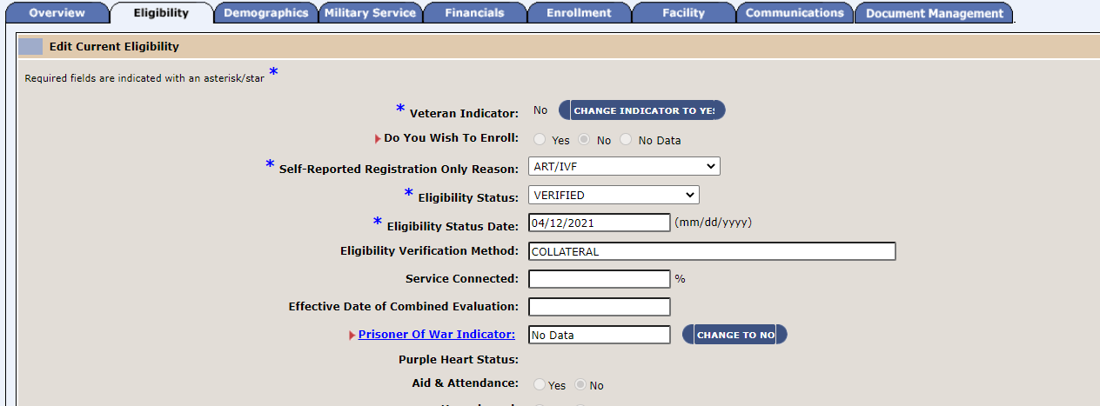
Registering a NEW Collateral in ES
Registering a new collateral
Do You Wish To Enroll: No
Self Reported Registration Only Reason: ART/IVF, COLLATERAL (OTHER), MARRIAGE/FAMILY COUNSELING/ NEWBORN, VHA TRANSPLANT PROGRAM
Eligibility Status: Verified
Eligibility Status Date: Today’s Date
Eligibility Verification Method: COLLATERAL

Slide 39
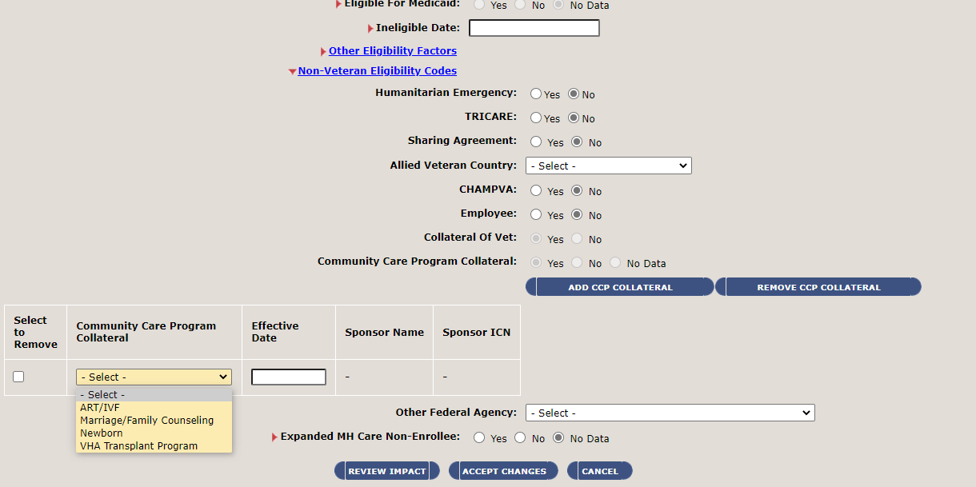
Registering a NEW Collateral in ES
Registering a new collateral
Scroll down to Non-Veteran Eligibility Codes.
For Collateral of Vet Y
For Community Care Program Collateral Y. (Only for a CCP Program Listed)
Select ADD CCP Collateral. Select the CCP from the dropdown and enter the Effective Date
Select Accept Changes

Slide 40
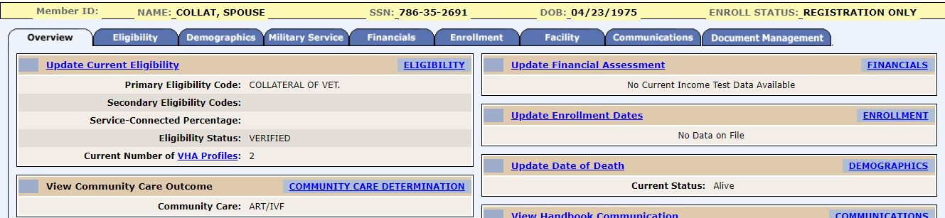
Registering a NEW Collateral in ES
Registering a new collateral
Enrollment Status will set to Registration Only
Primary Eligibility Code will set to Collateral of Vet

Slide 41
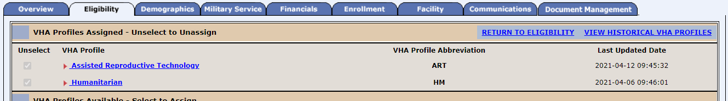
VHA Profiles Assigned
Registering a new collateral
VHA Profiles will be their primary CCP and Humanitarian.

Slide 42
HUD-VASH Registration
VHA Member Services – Enterprise Support Services

Slide 43
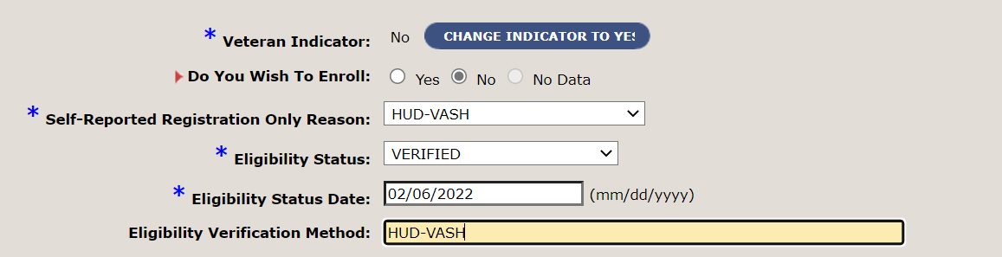
HUD-VASH Registration in ES
Veteran Indicator: No
Do You Wish To Enroll: No
Self Reported Registration Only Reason: HUD-VASH
Eligibility Status: Verified
Eligibility Status Date: Today’s Date
Eligibility Verification Method: HUD-VASH

Slide 44
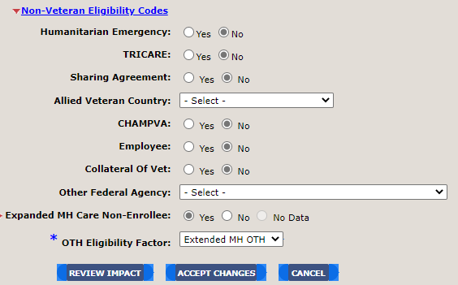
HUD-VASH Registration in ES
Under Non-Veteran Eligibility Codes select the following:
Expanded MH Care Non-Enrollee: Yes
OTH Eligibility Factor: Extended MH OTH
Select Accept Changes

Slide 45
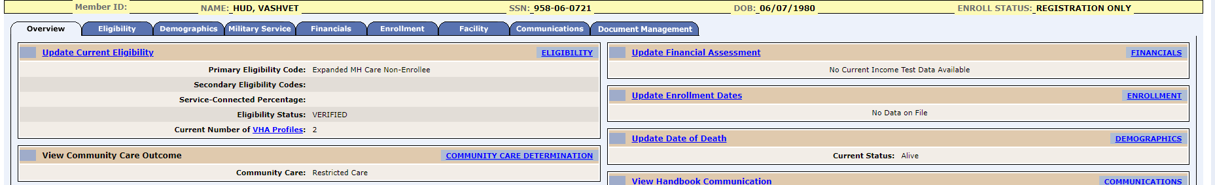
HUD-VASH Registration in ES
Enrollment Status: Registration Only
Primary Eligibility Code: Expanded MH Care Non-Enrollee

Slide 46
Veterans Registration

Slide 47
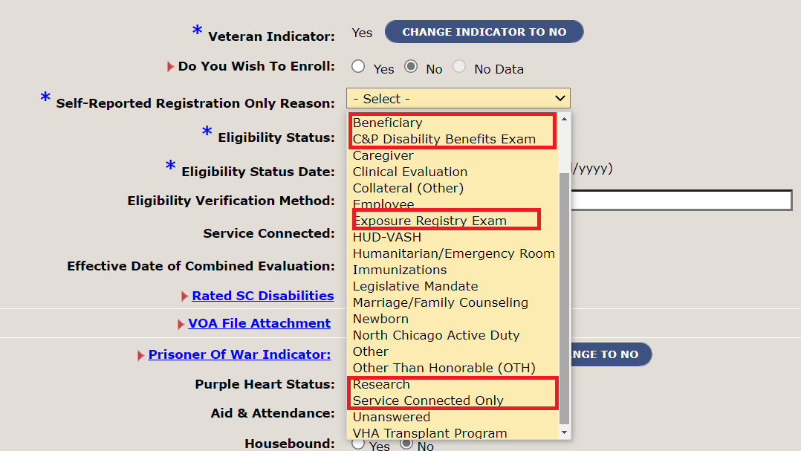
Veterans that do not wish to enroll
Veteran Indicator: Yes
Do You Wish To Enroll: No
Self-Reported Registration Reason: Select appropriate reason from drop-down
Eligibility Status: Verified
Eligibility Status Date: Today’s Date
Eligibility Verification Method: Use appropriate source or reason
Select Accept Changes.

Slide 48
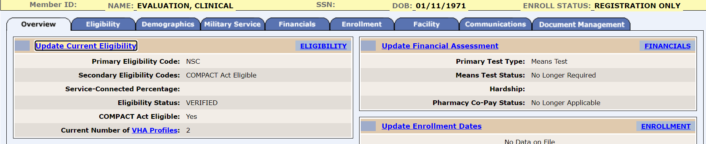
Veterans that do not wish to enroll
The Enrollment Status to ‘Registration Only’ and Primary Eligibility Code will be Non-Service Connected for those without service connections.
Relation Type – Associate Change History Page

Slide 49
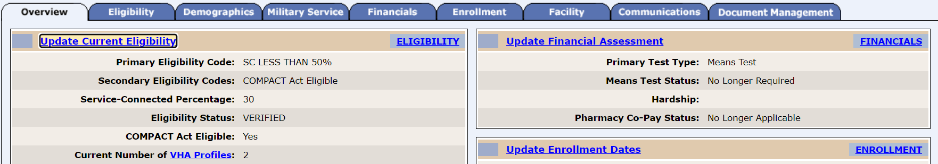
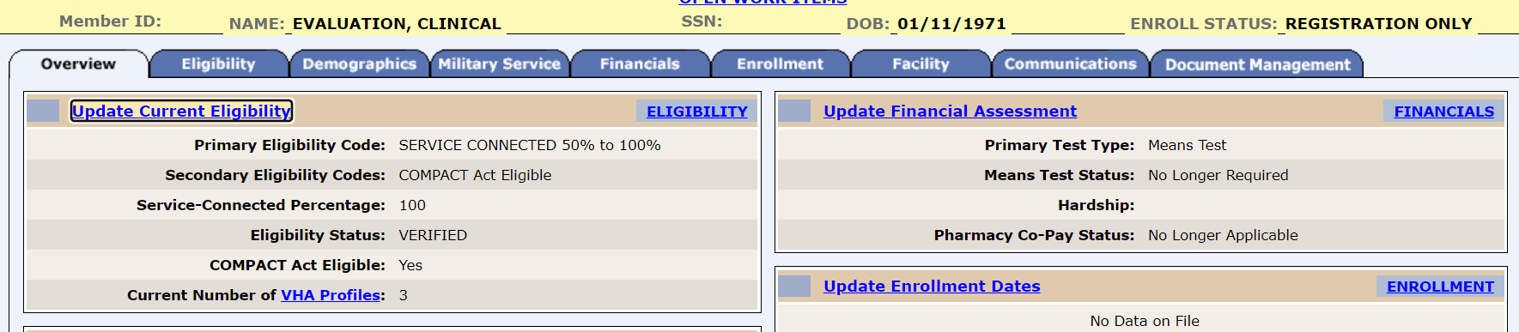
Veterans that do not wish to enroll
The Enrollment Status to ‘Registration Only’ and Primary Eligibility Code will be SC LESS THAN 50% or SERVICE CONNECTED 50% to 100% for those without service connections.
Relation Type – Associate Change History Page

Slide 50
Employees and Veteran Employee Registration

Slide 51
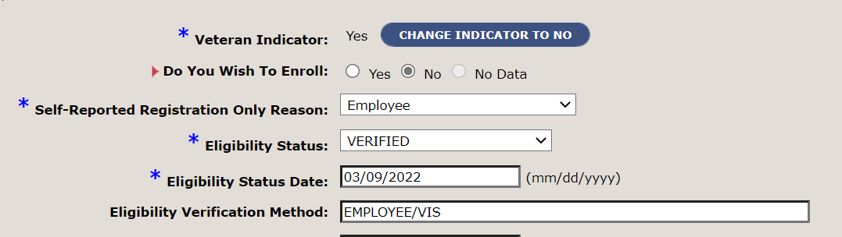
Employee registration
Veteran Indicator: No
Do You Wish To Enroll: No
Self-Reported Registration Reason: Employee
Eligibility Status: Verified
Eligibility Status Date: Today’s Date
Eligibility Verification Method: Employee

Slide 52
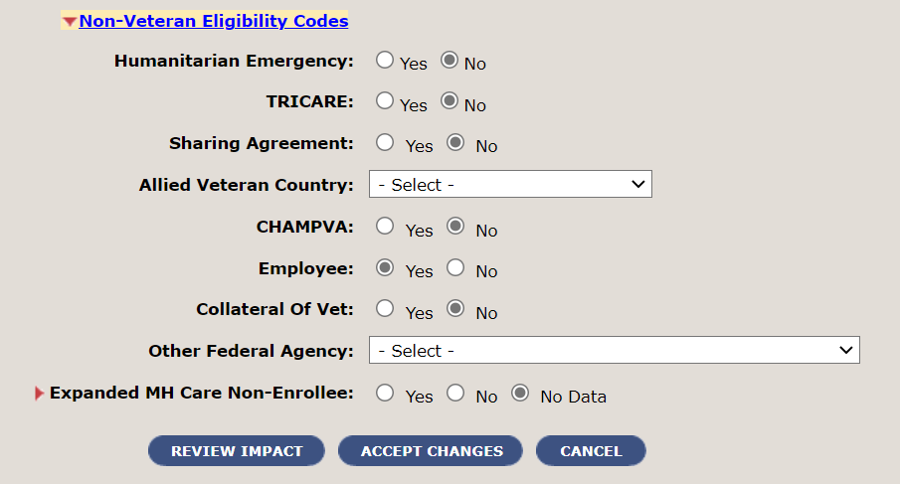
Employee registration
Under Non-Veteran Eligibility Codes for:
Employee: Yes
Select Accept Changes.
Relation Type – Associate Change History Page

Slide 53
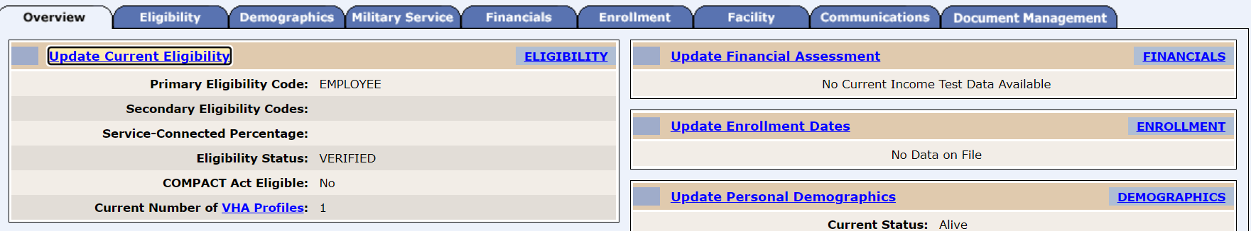
Employee registration
The Enrollment Status to ‘Registration Only’ and Primary Eligibility Code will be Employee.
All Employee records will be marked as “Sensitive Record”
Relation Type – Associate Change History Page

Slide 54
Veteran EMPLOYEES that do not wish to enroll
Veteran Indicator: Yes
Do You Wish To Enroll: No
Self-Reported Registration Reason: Employee
Eligibility Status: Verified
Eligibility Status Date: Today’s Date
Eligibility Verification Method: Employee/Verification System/Source Used (e.g. VIS, DD214).
Select Accept Changes.
Relation Type – Associate Change History Page

Slide 55
Veteran employees that do not wish to enroll
Under Non-Veteran Eligibility Codes for:
Employee: Yes
Select Accept Changes.
Relation Type – Associate Change History Page

Slide 56
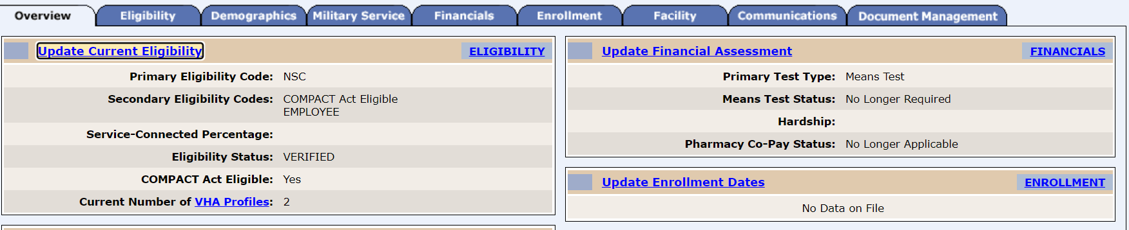
Veteran employees that do not wish to enroll
The Enrollment Status to ‘Registration Only’ and Primary Eligibility Code will be Non-Service Connected for those without service connections.
All Employee records will be marked as “Sensitive Record”
Relation Type – Associate Change History Page

Slide 57
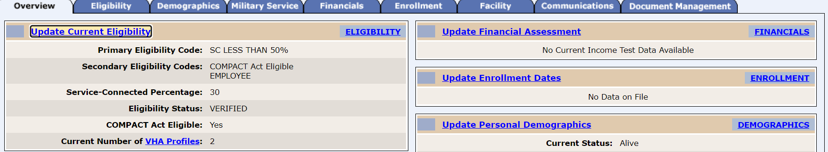
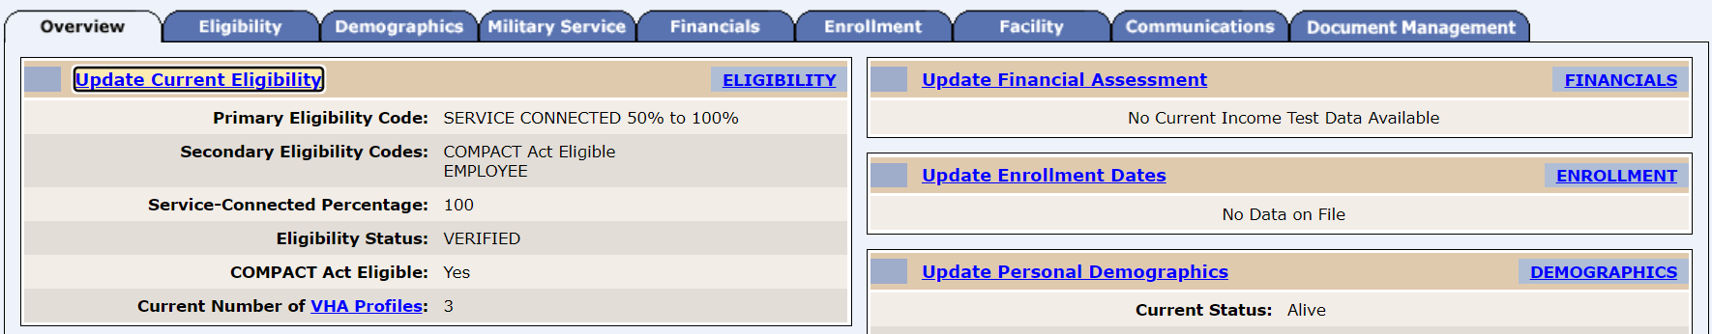
Veteran employees that do not wish to enroll
The Enrollment Status to ‘Registration Only’
Primary Eligibility Code will be SC LESS THAN 50%, or
SERVICE CONNECTED 50% to 100% for those with service connections.
All Employee records will be marked as “Sensitive Record”
Relation Type – Associate Change History Page

Slide 58
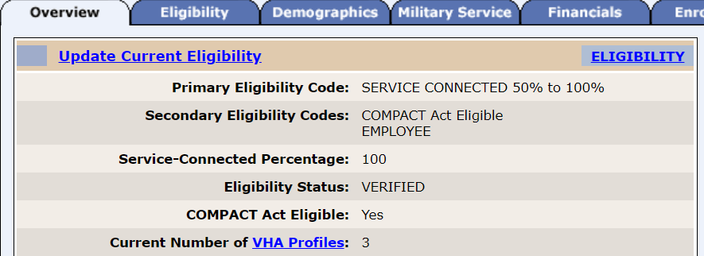
MANUALLY ASSIGNING EMPLOYEE VHAPS
From the Overview tab select VHA Profiles
Relation Type – Associate Change History Page
Under VHA Profiles Available – Select to Assign. Select the appropriate Employee option.

Slide 59
Humanitarian/Emergency Room Registrations

Slide 60
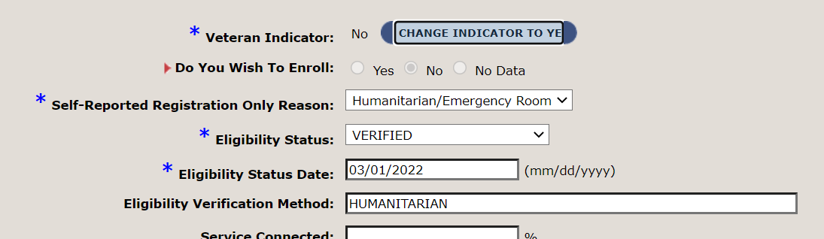
Humanitarian/emergency registrations
Veteran Indicator: No
Do You Wish To Enroll: No
Self-Reported Registration Reason: Humanitarian/Emergency Room
Eligibility Status: Verified
Eligibility Status Date: Today’s Date
Eligibility Verification Method: Humanitarian
Relation Type – Associate Change History Page

Slide 61
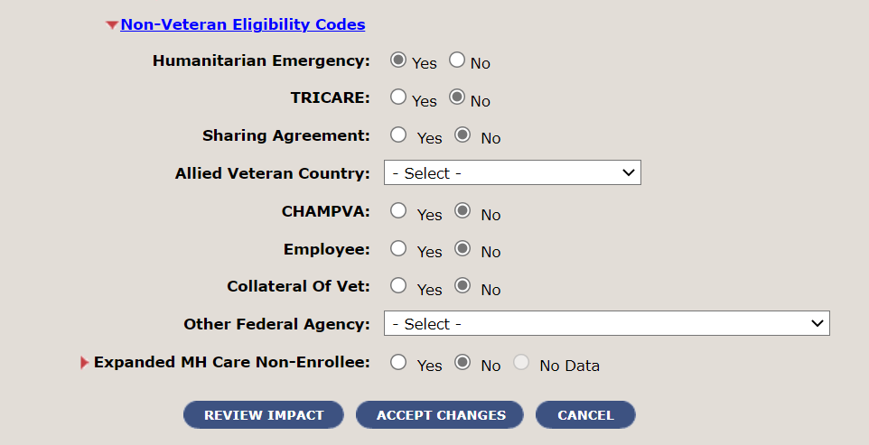
Humanitarian/emergency registrations
Under Non-Veteran Eligibility Codes for:
Humanitarian Emergency: Yes
Select Accept Changes.
Relation Type – Associate Change History Page

Slide 62

Humanitarian/emergency registrations
The Enrollment Status to ‘Registration Only’ and Primary Eligibility Code will be Humanitarian Emergency.
Relation Type – Associate Change History Page

Slide 63
Resources
Knowledge Management (KM) Articles and Resources
(VAMC Enroll_Elig) ADSM with Prior Veteran Status – JA
(VAMC Enroll_Elig) VES_Title 32 ADSM Registration – JA
(VAMC Enroll_Elig) VES ADSM with an FDD Registration – JA
(VAMC Enroll_Elig) Future Date of Discharge – JA
Registration Only Reasons (va.gov)
(VAMC Enroll_Elig) VES_Collateral Registration – JA
(VAMC Enroll_Elig) VES_Employee or Non-Veteran Registration – JA
(VAMC Enroll_Elig) VES_HUD-VASH Registration – JA
(VAMC Enroll_Elig) VES_OTH Mental and Behavioral Health Eligibility Registration – JA
(VAMC Enroll_Elig) VES_Presumptive Psychosis Registration – JA
(VAMC Enroll_Elig) VES MST Registration – JA
(VAMC Enroll_Elig) VES Veteran Registration - JA

